Slide 1
AI Fundamentals, MMAI 5000 S5 – Machine learning – Unsupervised ML Clustering Hemant Sangwan

Slide 2
Agenda – UnSupervised Machine learning
Unsupervised ML
Clustering
Fundamentals of clustering analysis
Key inputs to clustering analysis
Feature selection and distance measures in clustering
Algorithms for clustering analysis
Hierarchical clustering (linkage methods, Ward’s minimum variance)
Non-hierarchical clustering (k-mean)
Criteria for selecting clustering solutions: modelling criteria, business criteria
Generalized Mixture Models

Slide 3
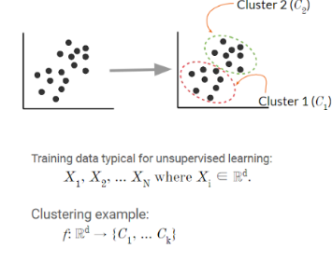
Machine learning – Unsupervised
Machine learning – a program that learns from experience
Unsupervised: The computer is “left on its own” to find structure in the data and learn the relationships between various inputs
It create an internal representation of the input, capturing regularities/structure/patterns in data, i.e., unlabeled data, i.e., no distinction between dependent and independent variables
Question – What is the target variable in the figure given here?

Slide 4
Importance of Unsupervised ML
Most “naturally occurring” data is unlabeled, labeled data sets are often manually compiled
There are tons hidden patterns and trends in unlabeled data that we can learn with unsupervised machine learning
Examples
Images and video
Text and language
Speech and audio
Medical and genetic
Relational and social network data

Slide 5
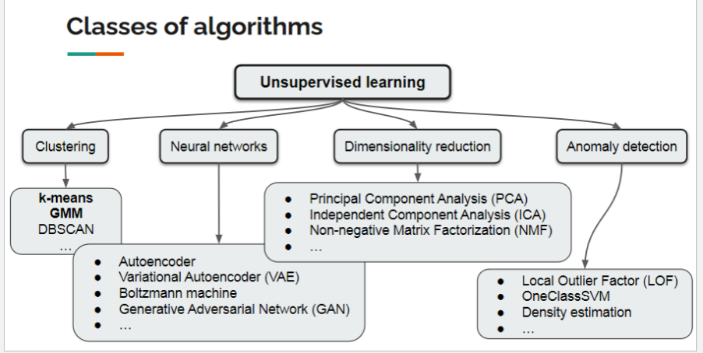
What can be done with Unsupervised ML
Find clusters in the data: market segmentation, image segmentation, signal separation
Compress data, i.e. dimensionality reduction: Image/sound compression, visualization
Detect anomalies: fraud detection, manufacture

Slide 6
Clustering Analysis

Slide 7
Making Sound Business Decisions with Clustering Analysis

Slide 8
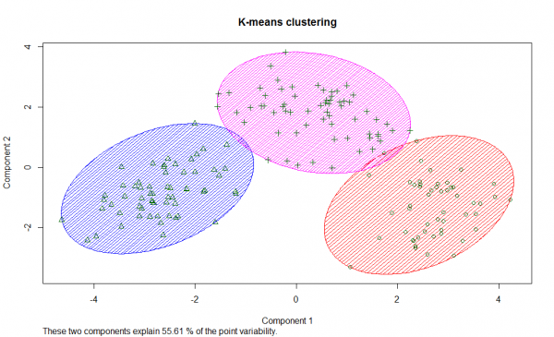
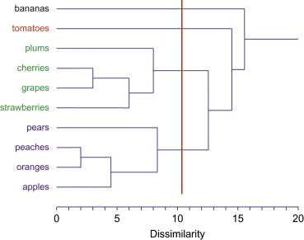
Making Sound Business Decisions with Clustering Analysis
Non-Hierarchical clustering
Hierarchical clustering

Slide 9
Agenda – Clustering Analysis
Fundamentals of clustering analysis
Geometrical
Analytical
Key inputs to clustering analysis
Feature selection
Distance measures
Methodologies / algorithms for clustering analysis
Hierarchical clustering (linkage methods, Ward’s minimum variance)
Non-hierarchical clustering (k-mean)
Criteria for selecting the final clustering solutions
Numeric results
Strategic criteria
Your judgment
Profiling Segments
Targeting

Slide 10
Agenda – Making Sound Business Decisions with Clustering Analysis
In this session, we will discuss clustering approach using the following items
Learning fundamentals of clustering using real world examples (what and why)
Explaining methodological approach to clustering
Geometrical and Analytical
Key inputs to clustering analysis: Feature selection and distance measures
Algorithms: Hierarchical clustering (e.g., linkage methods), Non-hierarchical clustering (k-mean)
Criteria for finalizing clustering solutions: Modeling criteria, business criteria, judgement
Describing evolution of business trends around Clustering: Mass marketing (no clustering), segmentation (traditional clustering), personalization (individual targeting)

Slide 11
Overview – Making Sound Business Decisions with Clustering
Clustering is about identifying a group of customers for whom business and marketing activities can be directed profitability
Customer preferences, needs, and compatibility with products and services vary significantly
Clustering analysis enables businesses and other organizations to segments and classify customers, regions, brands, and products. Key benefits of clustering include
Clustering helps in decision making, i.e., we have a natural tendency to “classify” things, e.g. objects, humans, animals, firms, brands, etc.
Clustering (or classification) makes information processing easier
Clustering reveals structure/interesting patterns in data
We can classify things even when classification does not exist or not meaningful

Slide 12
Clustering Analysis

Slide 13
What is Clustering Analysis?
The scientific and analytical process of dividing the market such that
Customers within a cluster are SIMILAR to each other
(within cluster homogeneity as high as possible)
Customers between clusters are as DIFFERENT from each other as possible
(between cluster homogeneity as high as possible)
Similarity and difference among customers are along key dimensions (aka features)

Slide 14
Selfie and Picture taking behaviour
How frequently do you take photos? (Select only one)
Daily, 2-4 times a week, once a week, once every 2-4 weeks, once a month, once every 2-6 months, once every 6 to 12 months, once a year, less than once a year, never
What devices you use to take photos? (Select all that apply)
Smartphone (e.g., I-phone, Samsung galaxy, etc.), point and shoot camera, digital SLR camera, film camera, tablet (e.g., I-pad), laptop, other
What is your MOST favourite topic/theme for taking photos? (Select only 1)
Food, fun moments (friends), fun moments(animals), shopping items, nature, special events (e.g., birthdays, wedding, graduation party, vacations, etc.)
What do you do once you have taken photos? (Select up to 3 choices)
Share them instantly on social media sites (Facebook, Twitter, Snapchat, Instagram, etc.), share them on social media site after editing/applying filters, leave them on the device you used to take photos, transfer them to an external hard drive, share them by emailing, take printouts, other

Slide 15
Poll 1 – Selfie and Picture taking behaviour
What is your MOST favourite topic/theme for taking photos? (Select only 1)
Food
fun moments (friends)
fun moments(animals)
shopping items
nature
special events (e.g., birthdays, wedding, graduation party, vacations, etc.)

Slide 16
Poll 2 – Selfie and Picture taking behaviour
What do you do once you have taken photos? (Select up to 3 choices)
Share them instantly on social media sites (Facebook, Twitter, Snapchat, Instagram, etc.)
Share them on social media site after editing/applying filters
Leave them on the device you used to take photos
Transfer them to an external hard drive
Share them by emailing
Take printouts
Other

Slide 17
Clustering – Future of smartphone experience
Adaptable/Foldable screens to be the new normal – BIGGER is always better!
Gaming smartphones becoming mainstream
Bigger and slimmer batteries supported by anywhere charging
Advancement in the Camera Segment
Sustainable tech
Source: Trends that will influence the future of smartphone experience. Retrieved from https://www.livemint.com/technology/trends-that-will-influence-the-future-of-smartphone-experience-11652107046977.html

Slide 18
Benefits of Clustering (or classification) Analysis?
Customer preferences, needs, and compatibility with products and service vary significantly
We need to find a GROUP of people to whom these marketing activities can be directed PROFITABILITY
We have a natural tendency to “classify” things, e.g., objects, humans, animals, firms, brands, etc.
Classification makes information processing easier
Classification reveals structure/interesting patterns in data
We can classify things even when classification does not exist or not meaningful

Slide 19
Activity – When clustering is not meaningful
Identify and list two examples when clustering (or classification) does not exist or not meaningful

Slide 20
Key inputs (or challenges) to Clustering Analysis?
Identifying and selecting the dimensions or features (e.g., willingness to pay, desired level of customer service, delivery preference – within 24 hours, 3-5 days, etc.) along which clustering needs to be done
Selecting a distance measure – a measure to quantify similarity or difference between customers and objects

Slide 21
Challenges to Clustering Analysis (Identifying and selecting dimensions, i.e., feature selection)
Selecting dimensions (or features)
In how many ways you can do classify 52 playing cards? (by colour, by suit, by shape)
Which of these grouping (or clustering) is the best?
Suppose you have data on 100 variables measuring customer personality types and another 100 for measuring customer experience with wireless services
For clustering (or segmentation), how many variables would you choose? And why?
All 200, 50 from each set, 25 from each set, randomly selected 50, etc.

Slide 22
Challenges to Clustering Analysis (measuring distance)
If you prefer “action” movies and your spouse “drama”, what would be the numerical measure of difference in your preferences?
How much difference exist between customers with “low” and “high” price sensitivity?
Suppose you can use any of the two routes for commuting between home and office. Which of the routes is closer?
R1: 25km, 40 minutes
R2: 35km, 30 minutes

Slide 23
What is “distance” in clustering?
A function with the following three properties
Symmetry: D(x1, x2)=D(x2, x1)
Triangle inequality: D(x1, x2) < D(x1, x3) + D(x3, x2)
Distinguishability: D(x1, x2)=0 ⇒ x1= x2 OR D(x1, x2)>0 ⇒ x1 ≠ x2
Distance is also called measure of “dissimilarity”
Example
Euclidean distance (most commonly used measure). d²= (x1-x2)² + (y1-y2)² between (x1, y1), (x2, y2)
Function d(x1, x2)= max (x1-x2, 0) is not a distance function!
Suppose x1=4, x2=6, then d(x1, x2)=max(4-6,0)=0; d(x2, x1)=max(6-4,0)=2→ d(x1, x2) ≠ d(x2, x1)

Slide 24
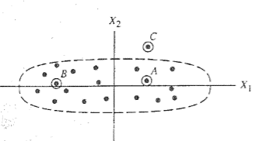
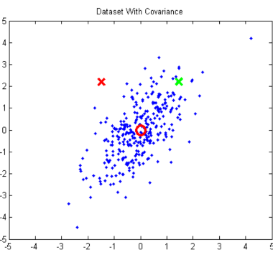
Commonly used “distance” measures in clustering
Euclidean distance. d²= (x1-x2)² + (y1-y2)² between (x1, y1), (x2, y2)
Statistical distance (x1, x2)
Probability between (x1, x2). Adjusted statistical distance, s² =(x1-x2)² / variance
A and C are closer under Euclidian distance. A and B are under Statistical distance
Mahalanobis distance: Red X is less likely to belong to the cluster than green X. But they both are equidistant from (0,0)

Slide 25
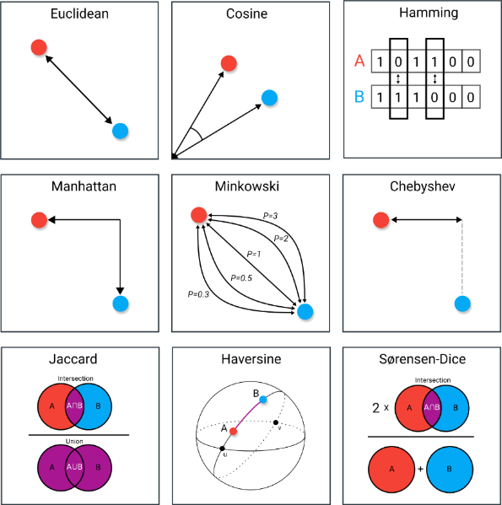
“Distance” measures in data science and analytics
9 Distance Measures in Data Science. The advantages and pitfalls of common distance measures. Maarteen Grootendorst. 2021. Retrieved from https://towardsdatascience.com/9-distance-measures-in-data-science-918109d069fa

Slide 26
Methodologies / Algorithms for clustering analysis
Hierarchical Clustering
It forms clusters in a hierarchical or sequential manner where at stage t, number of clusters is one less than those at stage t-1
Example: single linkage method, Ward’s minimum variance
Non-hierarchical clustering
All clusters are formed at the same time
Example: k-mean

Slide 27
Hierarchical Clustering
At the start, each customer n (e.g., n=1000) belongs to a separate cluster, i.e., n=1000 clusters, or each customer is a cluster
The algorithm starts merging clusters sequentially using a specific rule
Centroid
Nearest neighbour or single linkage
Farthest neighbour or complete linkage
Average linkage
Median linkage
Ward’s method

Slide 28
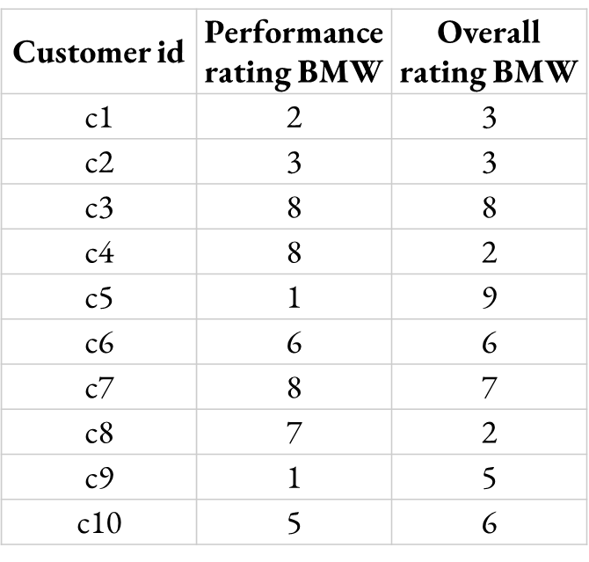
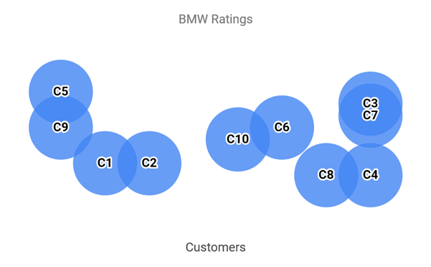
Hierarchical Clustering – Centroid
c1,c2, etc. are points in 2D (performance, overall rating)
Compute the distance between individuals and merge the closet individual to from a new cluster (c1, c2)→ c1c2 (or (c3, c7)→ c3c7). Note: from 10 initial clusters, we now have 9 clusters (c1c2, c3,c4….c9) in step 1
Repeat 1, assuming c1c2 is an added cluster and c1 or c2 no longer exist. Coordinates of c1c2 are Average (c1,c2)
Customer id | Performance rating BMW | Overall rating BMW
c1 | 2 | 3
C2 | 3 | 3
c1 & c2 (c1c2) | 2.5 | 3
c3 | 8 | 8
c4 | 8 | 2
c5 | 1 | 9
c6 | 6 | 6
c7 | 8 | 7
c8 | 7 | 2
c9 | 1 | 5
c10 | 5 | 6
Customer id | Performance rating BMW | Overall rating BMW
c1 & c2 (c1c2) | 2.5 | 3
c3 | 8 | 8
c4 | 8 | 2
c5 | 1 | 9
c6 | 6 | 6
c7 | 8 | 7
c3 & c7 (c3c7) | 8 | 7.5
c8 | 7 | 2
c9 | 1 | 5
c10 | 5 | 6
Step 1
(9 clusters)
Step 2
(8 clusters)

Slide 29
Hierarchical Clustering – Nearest Neighbour (single linkage)
c1,c2, etc. are points in 2D (performance, overall rating)
Compute the distance between individuals and merge the closet individual to from a new cluster (c1, c2)→ c1c2 (or (c3, c7)→ c3c7). Note: from 10 initial clusters, we now have 9 clusters (c1c2, c3,c4….c9) in step 1
Repeat 1, assuming c1c2 is an added cluster and c1 or c2 no longer exist. Coordinates of c1c2 are Minimum (c1,c2)
Customer id | Performance rating BMW | Overall rating BMW
c1 | 2 | 3
C2 | 3 | 3
c1 & c2 (c1c2) | 2 | 3
c3 | 8 | 8
c4 | 8 | 2
c5 | 1 | 9
c6 | 6 | 6
c7 | 8 | 7
c8 | 7 | 2
c9 | 1 | 5
c10 | 5 | 6
Customer id | Performance rating BMW | Overall rating BMW
c1 & c2 (c1c2) | 2 | 3
c3 | 8 | 8
c4 | 8 | 2
c5 | 1 | 9
c6 | 6 | 6
c7 | 8 | 7
c3 & c7 (c3c7) | 8 | 7
c8 | 7 | 2
c9 | 1 | 5
c10 | 5 | 6
Step 1
(9 clusters)
Step 2
(8 clusters)

Slide 30
Hierarchical Clustering – Farthest Neighbour (complete linkage)
c1,c2, etc. are points in 2D (performance, overall rating)
Compute the distance between individuals and merge the closet individual to from a new cluster (c1, c2)→ c1c2 (or (c3, c7)→ c3c7). Note: from 10 initial clusters, we now have 9 clusters (c1c2, c3,c4….c9) in step 1
Repeat 1, assuming c1c2 is an added cluster and c1 or c2 no longer exist. Coordinates of c1c2 are Maximum (c1,c2)
Customer id | Performance rating BMW | Overall rating BMW
c1 | 2 | 3
C2 | 3 | 3
c1 & c2 (c1c2) | 3 | 3
c3 | 8 | 8
c4 | 8 | 2
c5 | 1 | 9
c6 | 6 | 6
c7 | 8 | 7
c8 | 7 | 2
c9 | 1 | 5
c10 | 5 | 6
Customer id | Performance rating BMW | Overall rating BMW
c1 & c2 (c1c2) | 2 | 3
c3 | 8 | 8
c4 | 8 | 2
c5 | 1 | 9
c6 | 6 | 6
c7 | 8 | 7
c3 & c7 (c3c7) | 8 | 8
c8 | 7 | 2
c9 | 1 | 5
c10 | 5 | 6
Step 1
(9 clusters)
Step 2
(8 clusters)

Slide 31
Hierarchical Clustering – other linkage methods include median linkage, etc.
c1,c2, etc. are points in 2D (performance, overall rating)
Compute the distance between individuals and merge the closet individual to from a new cluster (c1, c2)→ c1c2 (or (c3, c7)→ c3c7). Note: from 10 initial clusters, we now have 9 clusters (c1c2, c3,c4….c9) in step 1
Repeat 1, assuming c1c2 is an added cluster and c1 or c2 no longer exist. Coordinates of c1c2 are Median (c1,c2)
Customer id | Performance rating BMW | Overall rating BMW
c1 | 2 | 3
C2 | 3 | 3
c1 & c2 (c1c2) | 2.5 | 3
c3 | 8 | 8
c4 | 8 | 2
c5 | 1 | 9
c6 | 6 | 6
c7 | 8 | 7
c8 | 7 | 2
c9 | 1 | 5
c10 | 5 | 6
Customer id | Performance rating BMW | Overall rating BMW
c1 & c2 (c1c2) | 2.5 | 3
c3 | 8 | 8
c4 | 8 | 2
c5 | 1 | 9
c6 | 6 | 6
c7 | 8 | 7
c3 & c7 (c3c7) | 8 | 8
c8 | 7 | 2
c9 | 1 | 5
c10 | 5 | 6
Step 1
(9 clusters)
Step 2
(8 clusters)

Slide 32
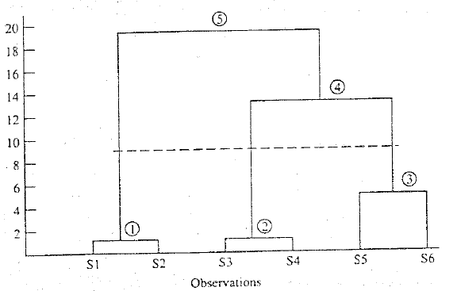
Hierarchical Clustering – Dendrogram
A branching diagram that represents the relationships of similarity among a group of entities
The circle → cluster formed
The vertical axis→ distance between clusters
The dotted line→ optimal number of clusters
From 6 individuals, we formed 3 clusters: customer (s1,s2), (s3,s4) and (s5,s6)

Slide 33
Hierarchical Clustering – Agglomerative vs Divisive
Agglomerative
At the start, each observation is a cluster, i.e., n observations are n clusters.
At each step, number of clusters shrink until we have 1 cluster containing ALL observations
Divisive
At the start, n observations are part of 1 cluster
At each step, we split observations into smaller clusters (i.e., # clusters increases) until we have each observation belonging to its own cluster (n clusters)

Slide 34
Non-Hierarchical Clustering
Number of clusters, k, are known in advance, i.e., k=5 clusters or 7 or 9 or 68
An algorithm for k-mean clustering (there are many algorithms)
Select k initial cluster centroids or seeds
Assign each observation to one of the k seeds with the shortest distance
Calculate centroid of k clusters
Reassign each observation to one of the k centroids with the shortest distance, i.e., go to step 2
Recalculate centroids of k clusters in step 4, i.e., go to step 3
Stop when distance of respective centroids in (step 3, step 5) < threshold

Slide 35
Non-Hierarchical, K-mean clustering

Slide 36
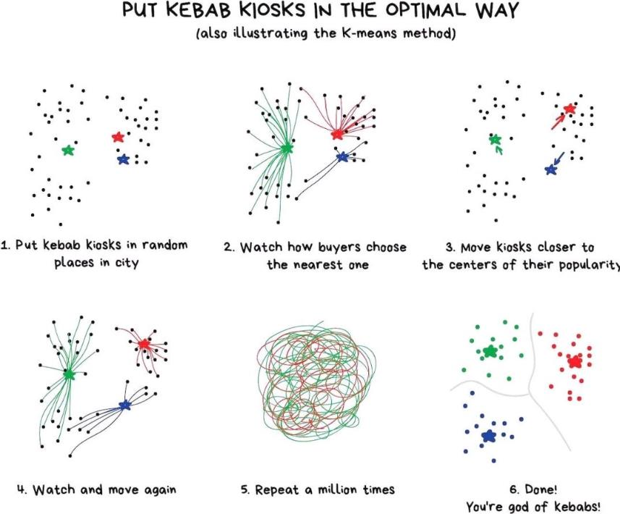
Non-Hierarchical, K-mean clustering

Slide 37
Non-Hierarchical, K-mean clustering
Individual | A=2, B=5, C=9, D=10, E=15
Initial Assignment | Cluster 1: A&C (Centroid=5.5) | Cluster 2: B&D&E (Centroid=10)
Individual | Assign to Group | Distance | Decision
A | 1: A&C | 3.5 | Keep in 1
A | 2: B&D&E | 8
B | 1: A&C | 0.5 | Move to 1
B | 2: B&D&E | 5
C | 1: A&C | 3.5 | Move to 2
C | 2: B&D&E | 1
D | 1: A&C | 4.5 | Keep in 2
D | 2: B&D&E | 0
E | 1: A&C | 9.5 | Keep in 2
E | 2: B&D&E | 5

Slide 38
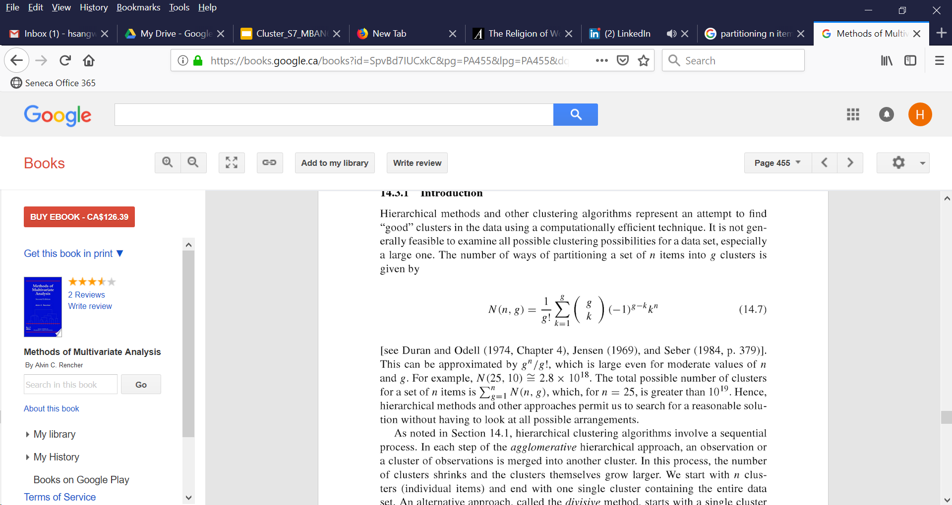
Non-Hierarchical Clustering – Maximum possible no of clusters
If there are ‘n’ observations (e.g., customers, firms, etc.), how many ‘g’ clusters can be formed?
Or in how many ways ‘n’ observations can be partitioned into ‘g’ groups?
n=25, g=10
n=25, g=1→ 1 cluster
n=25, g=2→ C₂²⁵=300 clusters
….
n=25, g=10→ C₁₀²⁵
1+ 300+.....+ C₁₀²⁵ = 2.8 x 10¹⁸

Slide 39
Hybrid Approach to Clustering
A hybrid clustering algorithm is a combination of hierarchical and non-hierarchical algorithms
Convergent Cluster Analysis (CCA) system. Retrieved from Sawtooth website http://www.sawtoothsoftware.com/download/techpap/ccatech.pdf (optional)

Slide 40
Optimal number of clusters – practical tips
Identify clustering problem correctly and narrowly – What are the key dimensions (or features) you need to cluster (segment) observations on?
Identify variables for all key dimensions
Standardize and normalize data, i.e., for each variable, subtract mean and divide by standard deviation so scaling doesn’t matter (Why?)
Run correlations among variables to see redundancy of variables
High correlations among variables can contaminate the clustering algorithm and can have significant impact on the quality of the solution
Final input data should include non-redundant sets of variables along each dimension
Run clustering algorithm→ get multiple clustering solutions
Examine the dendrogram
Are the cluster means different from each other?
Can you produce descriptive names for each cluster (e.g., professionals, techno-savvy, etc.)?

Slide 41
Choosing the best clustering solution
Cluster profiling: knowing the types of individuals in each cluster
Cluster means of variables included
Cluster means of descriptors
Demographic characteristics
After cluster profiling, you can finalize which specific clusters to choose for your marketing activities (target segment)
How do we communicate with a segment?
How do we design a product that is appropriate for a segment?
In both hierarchical and non-hierarchical clustering there are technical and non-technical (business) criteria to decide # of clusters and final solution

Slide 42
Clustering and Personalization
Personalization, Segmentation, and Mass Marketing

Slide 43
Personalized Targeting
“From ordering and paying ahead of time to creating your own Spotify playlist, the Starbucks app provides a user experience that is both inviting and innovative, much like the coffee chain itself.”
“Starbucks added personalization elements that allow the app to recall your favorite order, suggest what food items might pair well with that order, and suggest where you’d like to pick it up. Using the geolocation feature, a user can see where the closest Starbucks locations are, the menu at each location, and even place an order that can be ready upon arrival.” The Manifest, July 2018 (Medium.com)

Slide 44
Poll 3 – Personalization and Privacy
How concerned are you about brands identifying and predicting your preferences accurately?
Not at all concerned
Somewhat concerned
Extremely concerned

Slide 45
Example – Clustering
An equities analyst is studying the pharmaceutical industry and would like your help in exploring and understanding the financial data collected by her firm. Her main objective is to understand the structure of the pharmaceutical industry using some basic financial measures.
Financial data gathered on 21 firms in the pharmaceutical industry are available in the file. For each firm, the following variables are recorded:
Market capitalization (in billions of dollars), Beta, Price/earnings ratio, Return on equity, Return on assets, Asset turnover, Leverage, Estimated revenue growth, Net profit margin, Median recommendation (across major brokerages), Location of firm's headquarters, Stock exchange on which the firm is listed

Slide 46
Data – Clustering
Symbol | Name | Market capitalization (in billions of dollars) | Beta | Price/earnings ratio | Return on equity | Return on assets | Asset turnover | Leverage | Estimated revenue growth | Net profit margin | Median recommendation (across major brokerages) | Location of firm's headquarters | Stock exchange on which the firm is listed
Symbol | Name | Market_Cap | Beta | PE_Ratio | ROE | ROA | Asset_Turnover | Leverage | Rev_Growth | Net_Profit_Margin | Median_Recommendation | Location | Exchange
ABT | Abbott Laboratories | 68.44 | 0.32 | 24.7 | 26.4 | 11.8 | 0.7 | 0.42 | 7.54 | 16.1 | Moderate Buy | US | NYSE
AGN | Allergan, Inc. | 7.58 | 0.41 | 82.5 | 12.9 | 5.5 | 0.9 | 0.6 | 9.16 | 5.5 | Moderate Buy | CANADA | NYSE
AHM | Amersham plc | 6.3 | 0.46 | 20.7 | 14.9 | 7.8 | 0.9 | 0.27 | 7.05 | 11.2 | Strong Buy | UK | NYSE
AZN | AstraZeneca PLC | 67.63 | 0.52 | 21.5 | 27.4 | 15.4 | 0.9 | 0 | 15 | 18 | Moderate Sell | UK | NYSE
AVE | Aventis | 47.16 | 0.32 | 20.1 | 21.8 | 7.5 | 0.6 | 0.34 | 26.81 | 12.9 | Moderate Buy | FRANCE | NYSE
BAY | Bayer AG | 16.9 | 1.11 | 27.9 | 3.9 | 1.4 | 0.6 | 0 | -3.17 | 2.6 | Hold | GERMANY | NYSE
BMY | Bristol-Myers Squibb Company | 51.33 | 0.5 | 13.9 | 34.8 | 15.1 | 0.9 | 0.57 | 2.7 | 20.6 | Moderate Sell | US | NYSE
CHTT | Chattem, Inc | 0.41 | 0.85 | 26 | 24.1 | 4.3 | 0.6 | 3.51 | 6.38 | 7.5 | Moderate Buy | US | NASDAQ
ELN | Elan Corporation, plc | 0.78 | 1.08 | 3.6 | 15.1 | 5.1 | 0.3 | 1.07 | 34.21 | 13.3 | Moderate Sell | IRELAND | NYSE
LLY | Eli Lilly and Company | 73.84 | 0.18 | 27.9 | 31 | 13.5 | 0.6 | 0.53 | 6.21 | 23.4 | Hold | US | NYSE
GSK | GlaxoSmithKline plc | 122.11 | 0.35 | 18 | 62.9 | 20.3 | 1 | 0.34 | 21.87 | 21.1 | Hold | UK | NYSE
IVX | IVAX Corporation | 2.6 | 0.65 | 19.9 | 21.4 | 6.8 | 0.6 | 1.45 | 13.99 | 11 | Hold | US | AMEX
JNJ | Johnson & Johnson | 173.93 | 0.46 | 28.4 | 28.6 | 16.3 | 0.9 | 0.1 | 9.37 | 17.9 | Moderate Buy | US | NYSE
MRX | Medicis Pharmaceutical Corporation | 1.2 | 0.75 | 28.6 | 11.2 | 5.4 | 0.3 | 0.93 | 30.37 | 21.3 | Moderate Buy | US | NYSE
MRK | Merck & Co., Inc. | 132.56 | 0.46 | 18.9 | 40.6 | 15 | 1.1 | 0.28 | 17.35 | 14.1 | Hold | US | NYSE
NVS | Novartis AG | 96.65 | 0.19 | 21.6 | 17.9 | 11.2 | 0.5 | 0.06 | -2.69 | 22.4 | Hold | SWITZERLAND | NYSE
PFE | Pfizer Inc | 199.47 | 0.65 | 23.6 | 45.6 | 19.2 | 0.8 | 0.16 | 25.54 | 25.2 | Moderate Buy | US | NYSE
PHA | Pharmacia Corporation | 56.24 | 0.4 | 56.5 | 13.5 | 5.7 | 0.6 | 0.35 | 15 | 7.3 | Hold | US | NYSE
SGP | Schering-Plough Corporation | 34.1 | 0.51 | 18.9 | 22.6 | 13.3 | 0.8 | 0 | 8.56 | 17.6 | Hold | US | NYSE
WPI | Watson Pharmaceuticals, Inc. | 3.26 | 0.24 | 18.4 | 10.2 | 6.8 | 0.5 | 0.2 | 29.18 | 15.1 | Moderate Sell | US | NYSE
WYE | Wyeth | 48.19 | 0.63 | 13.1 | 54.9 | 13.4 | 0.6 | 1.12 | 0.36 | 25.5 | Hold | US | NYSE

Slide 47
Activity – Clustering
Use cluster analysis to explore and analyze the given dataset as follows:
Financial data gathered on 21 firms in the pharmaceutical industry are available in the file. For each firm, the following variables are recorded:
Use only the numerical variables (1-9) to cluster the 21 firms. Justify the various choices made in conducting the cluster analysis, such as weights for different variables, the specific clustering algorithm(s) used, the number of clusters formed, and so on.
Interpret the clusters with respect to the categorical variables used in forming the clusters.

Slide 48
Code – Clustering
from pathlib import Path
import pandas as pd
import numpy as np
from pandas.plotting import parallel_coordinates
from sklearn import preprocessing
from sklearn.cluster import KMeans
from sklearn.metrics import pairwise
from scipy.cluster.hierarchy import linkage, dendrogram, fcluster import matplotlib.pylab as plt
%matplotlib inline
pharma_df = load_data('PharmaData.csv')
pharma_df.set_index('Symbol', inplace=True)
pharma_df.head()

Slide 49
Code – k-mean Clustering
inertia = []
for n_clusters in range(1, 7):
kmeans = KMeans(n_clusters=n_clusters, n_init='auto', random_state=1).fit(pharma_norm)
inertia.append(kmeans.inertia_ / n_clusters)
inertias = pd.DataFrame({'n_clusters': range(1, 7), 'inertia': inertia})
ax = inertias.plot(x='n_clusters', y='inertia')
plt.xlabel('Number of clusters(k)')
plt.ylabel('Average Within-Cluster Squared Distances')
plt.ylim((0, 1.1 * inertias.inertia.max()))
ax.legend().set_visible(False)
plt.show()
kmeans = KMeans(n_clusters=4, n_init='auto', random_state=0).fit(pharma_norm)
centroids = {}
for key, item in pharma_data.groupby(memb):
centroids['Cluster {}'.format(key)] = item.mean()
pd.DataFrame(centroids).round(2)

Slide 50
Code – Hierarchical Clustering
pharma_data = pharma_df.drop(columns=['Name', 'Median_Recommendation', 'Location', 'Exchange'])
pharma_data.head()
pharma_norm = pharma_data.apply(preprocessing.scale, axis=0)
fig, axes = plt.subplots(nrows=3, ncols=3, figsize=(10, 7), squeeze=False)
for i, method in enumerate(['single', 'complete', 'average', 'weighted', 'centroid', 'median', 'ward']):
ax = axes[i // 3, i % 3]
Z = linkage(pharma_norm, method=method)
dendrogram(Z, color_threshold=0, ax=ax, no_labels=True)
ax.set_xlabel(method)
fig.delaxes(axes[2,1]) # remove empty subplots
fig.delaxes(axes[2,2])
Z = linkage(pharma_norm, method='ward')
memb = fcluster(Z, 4, criterion='maxclust')

Slide 51
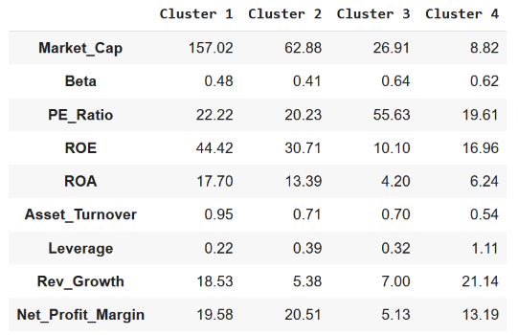
Analysis / results – k-mean Clustering
Cluster 1: large corporations, fast growing, profitable, and not leveraged
Cluster 2: moderate size (market cap), profitable and slow growing, not leveraged
Cluster 3: small companies, slow growing and of low profitability
Cluster 4: small companies, fast growing, profitable, and highly leveraged
Names
Cluster 1: The big boys, financial stars
Cluster 2: International establishment with decent financial performance.
Cluster 3: Slow growth mid-size
Cluster 4: Fast growth small-cap

Slide 52
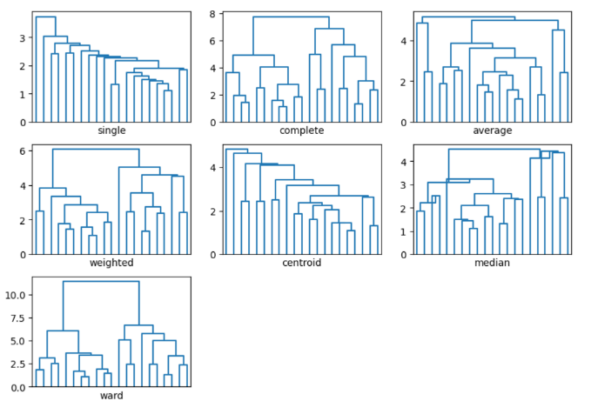
Analysis / results – Hierarchal Clustering

Slide 53
Summary
Clustering analysis is about identifying patterns and variations among customers (along key dimensions, or features) to segment them into different groups
Segment profiling, once clustering is complete, helps in selecting the most appropriate segments for marketing mix strategies
In finalizing clustering solutions, both technical and business criteria must be evaluated and balanced in the decision making

Slide 54
Activity
Read the following article and explain if / how Spotify is using clustering analysis? Based on the description, identify 5-10 specific variables which could be used in the clustering and identifying differences in customer preferences.
How Does Spotify Know You So Well? (2019). Retrieved from https://medium.com/s/story/spotifys-discover-weekly-how-machine-learning-finds-your-new-music-19a41ab76efe
If a few variables are categorical and other are continuous/internal scale, does it matter for clustering analysis? How do your analysis / results get impacted with a mix of categorical/continuous variables?

Slide 55
Gaussian Mixture Models (GMM)

Slide 56
Gaussain Mixture Models
“A Gaussian mixture model is a probabilistic model that assumes all the data points are generated from a mixture of a finite number of Gaussian distributions with unknown parameters.”
“One can think of mixture models as generalizing k-means clustering to incorporate information about the covariance structure of the data as well as the centers of the latent Gaussians.” Scikit Learn
GMM provides probabilistic views of clusters, i.e., an observation could belong to one of the three (k=3) clusters with probability [0.24, 0.36, 0.40]
K- mean does not account for variance in the data
K- mean is a deterministic model, each observation is assigned to 1 and only 1 cluster

Slide 57
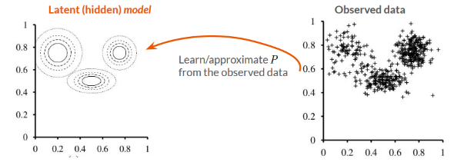
Gaussain Mixture Models
Data are generated from a mixture distribution P, with P having k components
The mixture distribution is not observed, i.e., latent or hidden
GMM learning tasks
Estimate the mixture distribution, based on observed data
Weight of a component: wi = P(c=i)
Mean of a component: 𝜇i
Covariance of a component: Σi
Image credit: Figure 20.11 in AIMA, 3rd ed by Russell and Norvig (2010)

Slide 58
GMM Estimaiton – EM Algorithm
Challenges
We do not know from which component a given observation came from
Compute the probability that the given observation came from a particular component
We do not know the parameters of the distribution
Estimate using initial guess and then iterations
EM Algorithm
E-step (expectation): Compute the probabilities pij = P(c=i|xj), i.e., the probability that point xj was generated by component i
M-step (maximization): Estimate new parameters (maximize the expectation)
𝜇i mean of component i
Σi covariance matrix of component i
wi weight of component i
Source: Gaussian Mixture Model. Scikit learn. Retrieved from https://scikit-learn.org/stable/modules/mixture.html

Slide 59
Suggested Readings
How Does Spotify Know You So Well? (2019). Retrieved from https://medium.com/s/story/spotifys-discover-weekly-how-machine-learning-finds-your-new-music-19a41ab76efe
Denver Post: “Are store rewards programs worthwhile? Mostly not. Retrieved from https://www.denverpost.com/2016/09/04/are-store-rewards-programs-worthwhile-mostly-not/
Gaussian Mixture Model. Scikit learn. Retrieved from https://scikit-learn.org/stable/modules/mixture.html
Gaussian Mixture Models (2019). Retrieved from https://towardsdatascience.com/gaussian-mixture-models-d13a5e915c8e

Slide 60
Appendix 1 – Ward’s method in clustering

Slide 61
Hierarchical Clustering – Ward’s minimum variance agglomerative clustering procedure
Does not compute distance between clusters
It forms clusters by maximizing within cluster homogeneity
Maximizing within cluster homogeneity ⇔ Minimizing within cluster error sum of square (ESS)

Slide 62
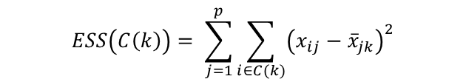

Error sum of Square (ESS)
Intuition: Deviation from mean (i.e. how different an observation is from its mean)
Suppose we have information on j = 1, …, p variables for i = 1, …, I individuals.
Denote the value of variable j for individual i as x (i, j)
Suppose clusters are indexed by k = 1, …, r
Denote C(k) as the set of individuals in cluster k (e.g., C(2)={3,7,10})
To compute Error Sum of Squares for a cluster k, first compute the within-cluster averages of each variable for each cluster. Note: N(k) = number of individuals in cluster k:
Then the ESS for cluster k is:
$${\overline{x}}_{jk}=\frac{1}{N_{k}}\sum_{i∈C(k)}{x_{ij}}$$
$$ESS\left(C\left(k\right)\right)= \sum_{j=1}^{p}{\sum_{i∈C(k)}{{\left(x_{ij}−{\overline{x}}_{jk}\right)}^{2}}}$$

Slide 63
Algorithm for Ward’s Clustering
Begin with each individual in their own cluster
Suppose we have r clusters: For all possible pairs of clusters k and k’, compute the increase in Error Sum of Squares (ESS) that would arise from combining those clusters
Combine the pair of clusters k and k’ that are closest to each other
Where the increase in Error Sum of Squares (ESS) computed from part 2) is smallest, resulting in r-1 clusters
Repeat steps 2-3 until there is only 1 cluster
Intuition: minimize within cluster variance at each step.

Slide 64

Algorithm for Ward’s Clustering
When combining clusters, for each pair of clusters k and k’, we calculate
We combine together the clusters for which $Δ\left(k,k^{′}\right)$ is the smallest
$$Δ\left(k,k^{′}\right)=ESS\left(C\left(k\right)∪C\left(k^{′}\right)\right)−ESS\left(C\left(k\right)\right)−ESS\left(C\left(k^{′}\right)\right)$$

Slide 65
Hierarchical Clustering – Ward’s method
Let’s combine c1 & c2 (vs c1 & c3)
ESS of (c1 & c2), c3, c4, c5, c6, c7, c8, c9, c10
ESS= (2-2.5)² + (3-2.5)² + (3-3)² + (3-3)² = 0.25 + 0.25 = 0.50
For (c3, c4...c10) each point is a cluster so ESS=0
ESS of (c1 & c3), c2, c4, c5, c6, c7, c8, c9, c10
ESS= (2-5)² + (8-5)² + (3-5.5)² + (8-5.5)² = 9+9+6.25+6.25 = 30.50
Ward method will favour c1 & c2 over (c1 & c3)
Customer id | Performance rating BMW | Overall rating BMW
c1 | 2 | 3
c2 | 3 | 3
c1 & c2 | 2.5 | 3
c3 | 8 | 8
c1 & c3 | 5 | 5.5
c4 | 8 | 2
c5 | 1 | 9
c6 | 6 | 6
c7 | 8 | 7
c8 | 7 | 2
c9 | 1 | 5
c10 | 5 | 6

Slide 66
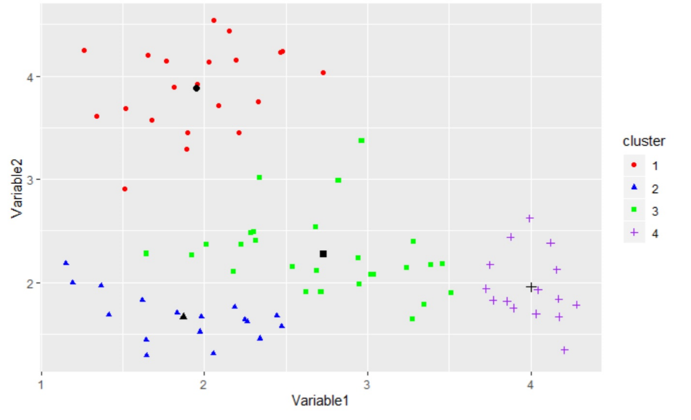
Ward’s method – visualization
Combining 2 and 3 will be preferred over 1 and 4
Increase in ESS: 85.74
Increase in ESS: 14.41

Slide 67
Ward’s method – creating a dendrogram
First Stage: A=2 B=5 C=9 D=10 E=15
Second Stage: AB = 4.5 BD = 12.5
AC = 24.5 BE = 50.0
AD = 32.0 CD =0.5
AE = 84.5 CE = 18.0
BC = 8.0 DE = 12.5
Third Stage: CDA =37.5 CDB =13.5 CDE =20.16 AB =4.5 AE =84.5 BE =50.0
Fourth Stage: ABCD = 36.0 ABE= 88.17 CDE = 20.18
Fifth Stage: ABCDE = 73.62

Slide 68
Appendix 2 – Machine Learning

Slide 69
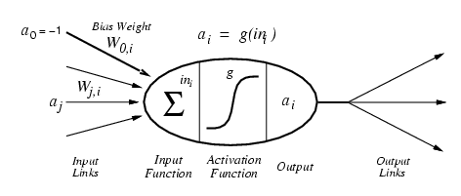
Machine Learning – Definition
"Machine learning is a field of computer science that gives computers the ability to learn [from data] without being explicitly programmed." Wikipedia

Slide 70
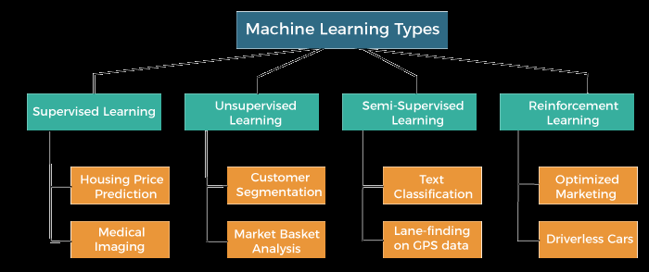
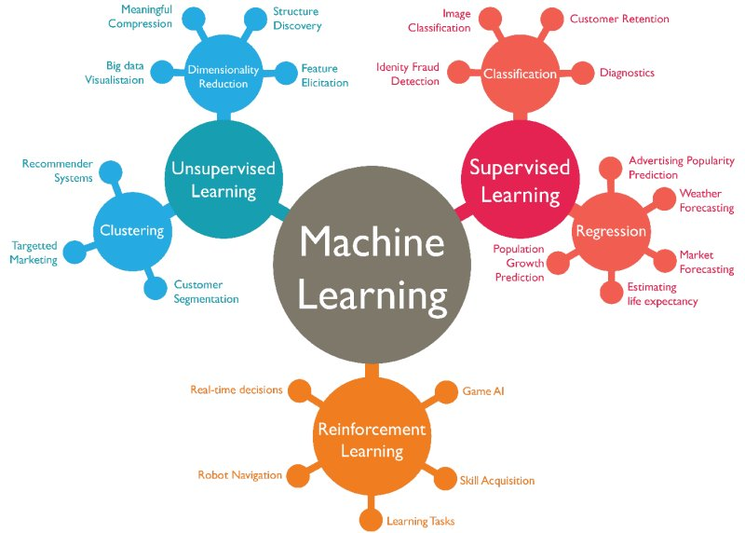
Machine Learning – Types and applications
Source: https://www.javatpoint.com/types-of-machine-learning
Source: https://www.kdnuggets.com/2019/04/poll-data-science-machine-learning-methods-algorithms-use-2018-2019.html

Slide 71
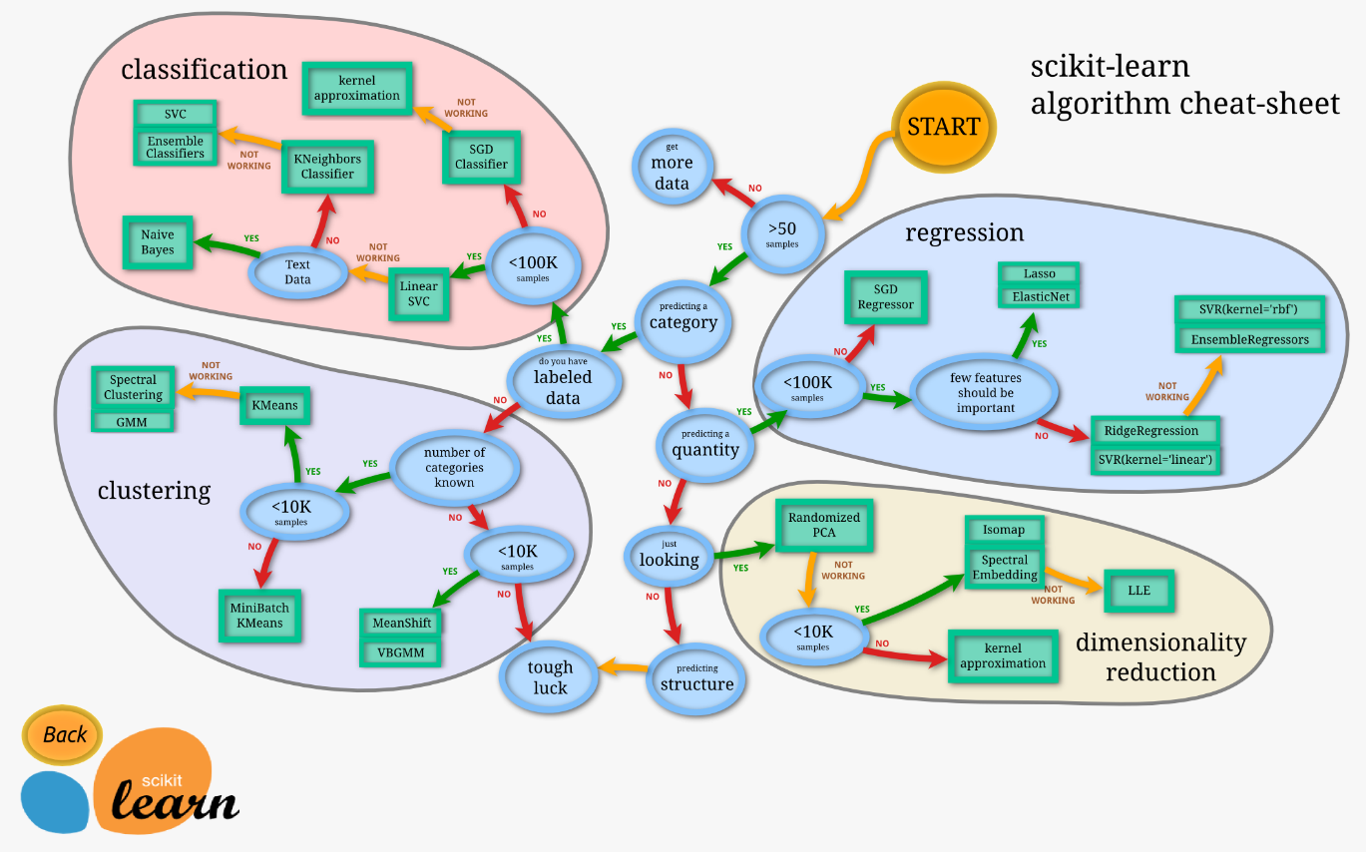
Machine Learning – Algorithms
Source: https://scikit-learn.org/stable/tutorial/machine_learning_map/index.html

Slide 72
Machine learning – Supervised
Machine learning – a program that learns from experience
Supervised: The computer is “taught” with examples of desired inputs and outputs and goal is to learn from “input-output” relationships
Assume an unknown function f that returns output y given some input X, i.e., y = f(X)
Supervised learning: learn a function h that approximates f. y ≈ h(X)
X= price, y= sales OR X = price, y = purchase or no purchase (categorical variable)

Slide 73
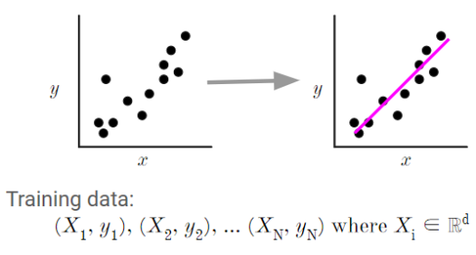
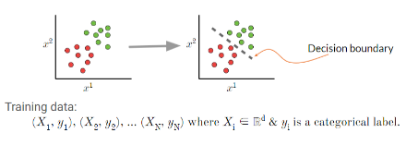
Machine learning – Supervised
An unknown function f that returns output y given some input X, i.e., y = f(X)
Supervised learning: learn a function h that approximates f. y ≈ h(X)
Correct output known for each training example, i.e., data are labeled, and the algorithm learns h that approximates f
X= price, y= sales; OR X = price, y = purchase / no purchase (categorical variable)
X= independent variable or feature, y = dependent variable or outcome
Question – What is the target variable in each of the figures given here?
and yi ∈ ℝ.

Slide 74
Machine learning – Unsupervised
Machine learning – a program that learns from experience
Unsupervised: The computer is “left on its own” to find structure in the data and learn the relationships between various inputs
It create an internal representation of the input, capturing regularities/structure/patterns in data, i.e., unlabeled data, i.e., no distinction between dependent and independent variables
Question – What is the target variable in the figure given here?

Slide 75
A few other types of learning
Classic: supervised, unsupervised, reinforcement
Hybrid:
Semi-supervised: a few labelled and many unlabeled data
Self-supervised: unsupervised learning with a supervised learner (e.g., language model)
Learning techniques
Multi-task learning: Supervised learning predicting multiple targets
Transfer learning: Train on one task and use the model on another task (often after fine-tuning)
Online learning: Update (train) the model as new data arrives

Slide 76
Machine learning – Supervised vs Unsupervised
Supervised
You are an investment analyst at a boutique firm in downtown Toronto. One of your clients loves investing in gold and thinks gold provides the best hedging against inflation than investing in stocks. The client provided you with the data on GP (gold price index), TSX index, and CPI (inflation index)
If your client’s brief is correct → gold prices rise faster than TSX relative to inflation. How to establish such relationship between (GP/CPI) or (TSX/CPI)
Predict GP (or TSX) as a function of CPI, i.e., if CPI rises by 1%, how much GP (or TSX) will rise?
UnSupervised
Your team has collected data on 150 financial ratios used to measure health of a firm. The client has asked if there is a way to reduce 150 ratios to 10 categories/indices to simplify the task and present it to the CEO?
10 indices should be able to capture almost all information which is available in 150 different types of ratios
Predict which specific category (10 categories) each ratio is going to be assigned to?

